Slide 1
VEHICULAR HEATSTROKE ALERTING SYSTEM
ADITHI PAI
ARVIND P JAYAN
Y V V S SAI PAVAN

Slide 2
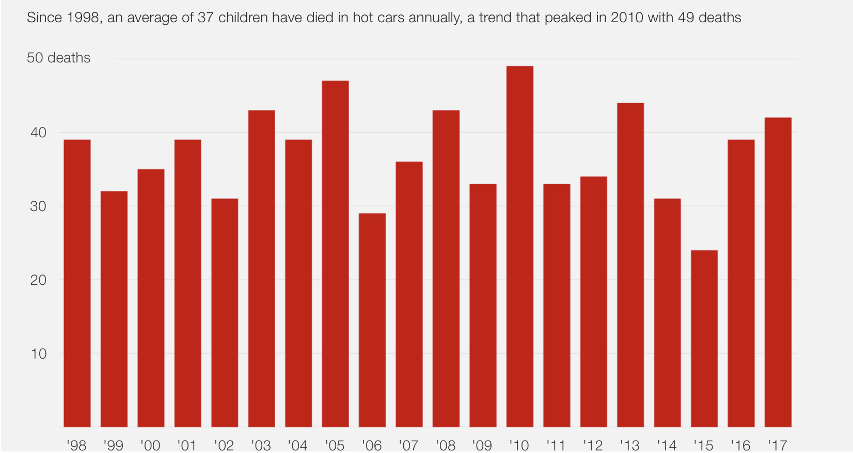
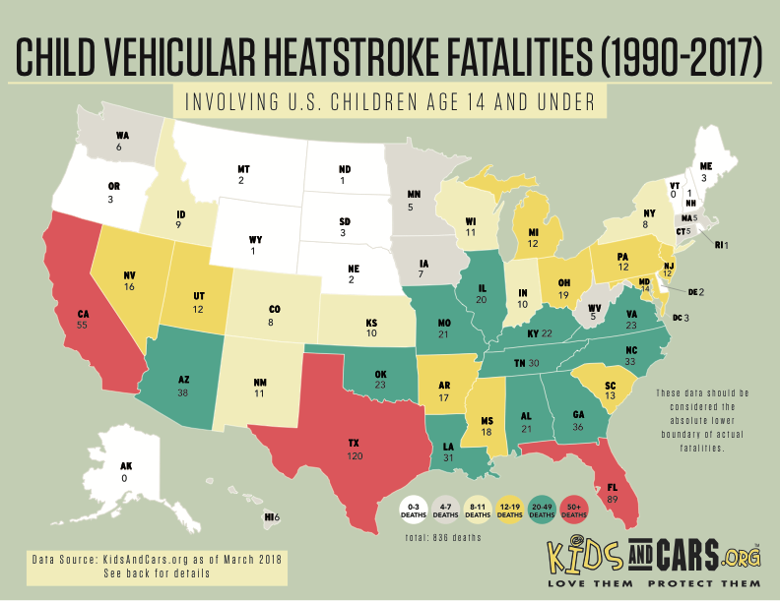
Vehicular heatstroke, hyperthermia. The devastating effects of a child being left in a hot car. The tragedy can happen almost anywhere, and while hotter months are always the riskiest, the circumstances surrounding child vehicular heatstroke are varied.

Slide 3
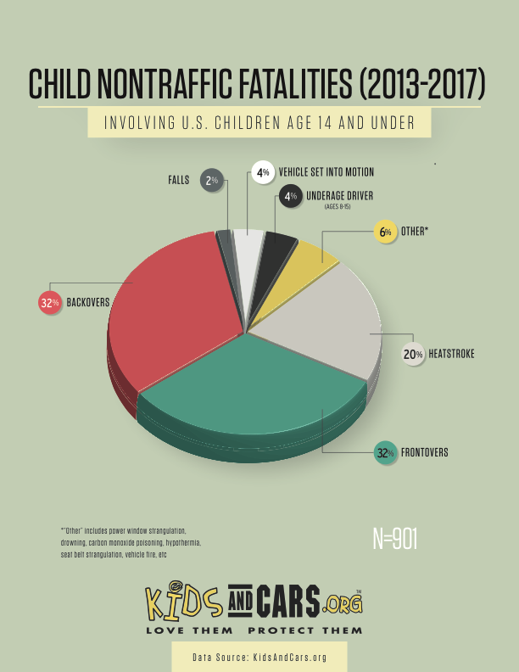
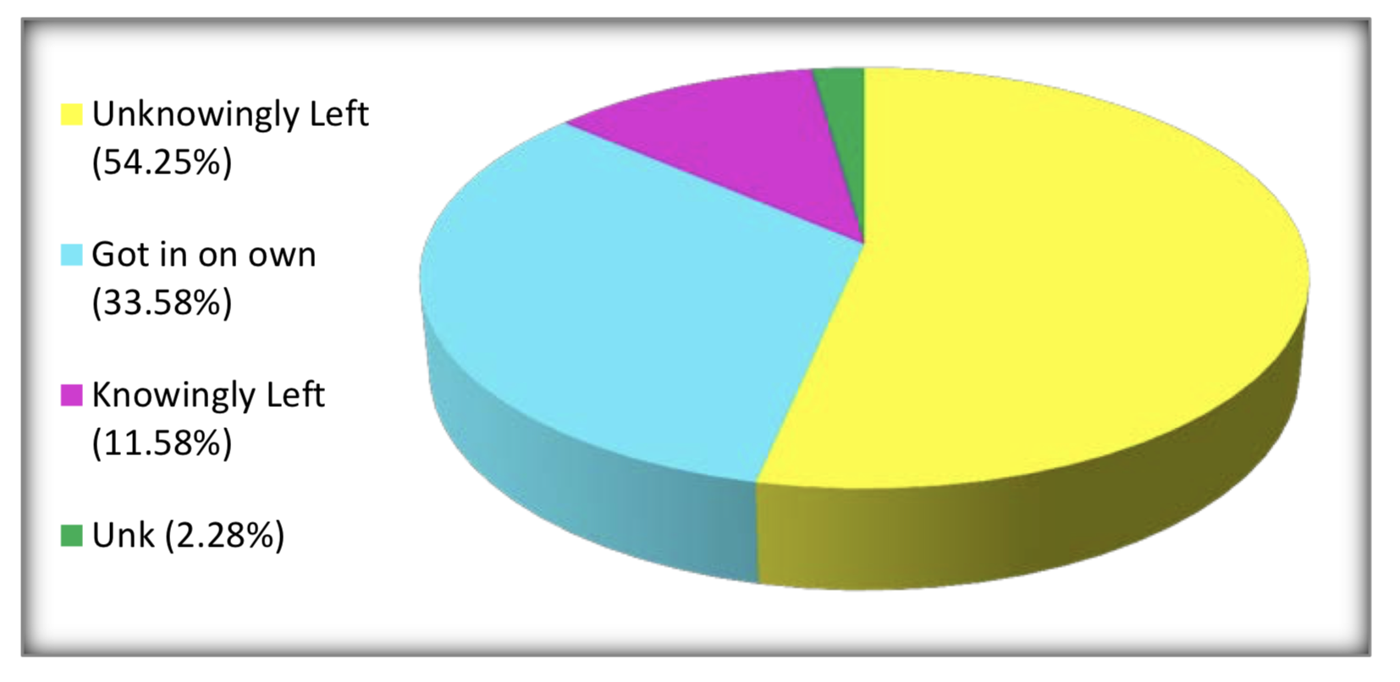
According to the safety organization Kids and Cars, an average of 37 children die each year in hot cars. These include instances where a child has been forgotten in a car, accidentally locks themselves in a car or trunk, or, in a small number of cases, when a child has been intentionally left in a car.

Slide 4
IoT SOLUTION
Our IoT solution is to create a system to recognize the presence of children, adults or animals inside the vehicle when the vehicle’s engine is switched off. If this happens for a long interval of time, temperature and presence of toxic gases increases considerably then the responsible adults will be alerted first, if no action is taken beyond a threshold time local authority will be alerted also.
We are using web cams to detect the presence of kids who are left alone in vehicles, if more than a face is found when the vehicle is switched off, the amount of toxic gases is detected using air quality sensor and temperature using an analog temperature sensor.
Based on the intensity alerts are given:
If moderate - Alert parents
If above the threshold value - Alert Local authorities and Parents

Slide 5
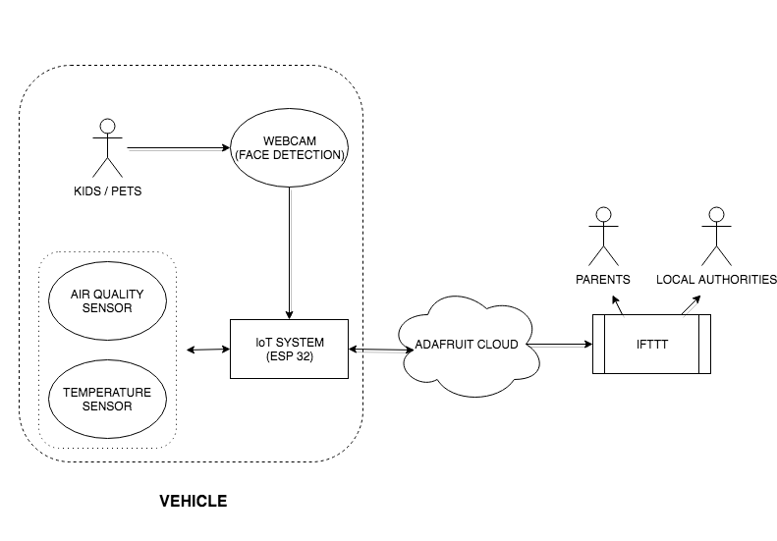
OUR SYSTEM

Slide 6
ASSUMPTIONS
The placement of camera covers the whole car and detects only faces.
If no faces are detected then there are no one inside the car.
Alert system implemented will work effectively.
Air quality sensor will not be triggered by low amounts of CO2.

Slide 7

IMPROVING ACCURACY
By adding a thermal sensor and PIR sensor, will be more accurate in detecting the presence of a child inside a vehicle.

Slide 8
THANK YOU

